Slide 2
Placement

Slide 3
Placement
Contains two body system values
Anatomical Regions
Anatomical Orifices
Five root operations unique to this section
Compression - Putting pressure on a body region
Dressing - Putting material on a body region for protection
Immobilization - Limiting or preventing motion of a body region
Packing - Putting material in a body region or orifice
Traction - Exerting a pulling force on a body region in a distal direction
Two root operations common to other sections
Change
Removal

Slide 4
Placement
Body Regions/Orifices
Two types of values:
External body regions (e.g., chest wall) –
Natural orifices (e.g., mouth and pharynx)
Devices
Specifies the material or device in the placement procedure (e.g., splint, bandage)
Includes casts for fractures and dislocations
Devices in the placement section are off the shelf and do not require any extensive design, fabrication or fitting
The placement of devices that require extensive design, fabrication or fitting are coded in the Rehabilitation section

Slide 5
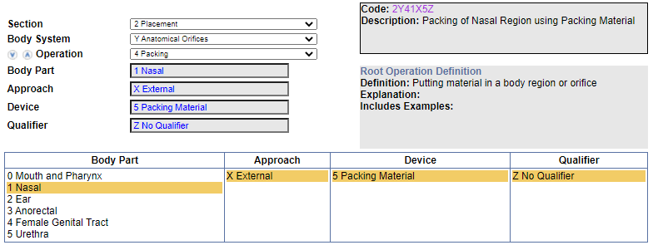
Clinical Examples
The patient presents to the Emergency Department (ED) and is admitted as an inpatient for treatment of epistaxis associated with anticoagulant use. While in the ED, the provider packed the nose with a nasal tampon to stop the bleeding. What is the appropriate ICD-10-PCS code assignment for the use of nasal tampon to treat epistaxis
Coding Navigation:

Slide 6
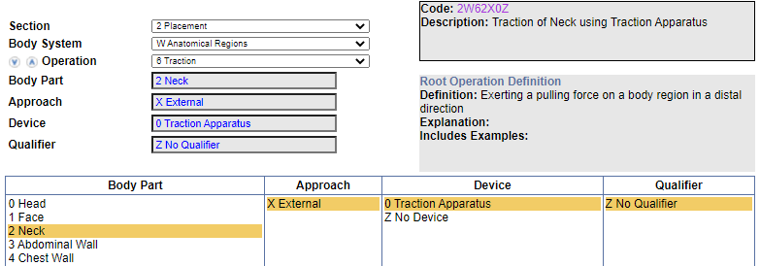
Clinical Examples
The patient suffered an unstable fracture of the cervical spine. Tongs were applied and left in place in order to stabilize the fracture. What is the ICD- 10-PCS procedure code for application of tongs for cervical fracture?
Assign the following codes for the application of cervical tongs for reduction of cervical fracture:
0PS3XZZ Reposition cervical vertebra, external approach
2W62X0Z Traction of neck using traction apparatus
Code Navigation:

Slide 7
Coding Clinic
A patient presents for debridement of a full-thickness burn to the left lower leg. The provider performs excisional debridement down to and including fascia, and then covers the wound bed with a bioabsorbable wound dressing. The dressing consists of a biocompatible synthetic matrix placed onto the wound to provide a framework for the tissue to regenerate, temporarily closing the wound. Is this classified as wound dressing, skin replacement or other therapeutic substance? What is the appropriate ICD-10-PCS code for the application of a biodegradable wound dressing?
Answer:
This wound dressing consists of a synthetic bioabsorbable matrix. In ICD-10-PCS, wound dressings are considered surgical supplies, and surgical supplies are not coded separately in an inpatient setting.

